Slide 1

Life After CS106A
Chris Piech
CS106A, Stanford University

Slide 2
FacePamphlet

Slide 3
The Final

Slide 4


First day
3
+
+
+
+
2
+
+
+
+
1
+
+
+
+
1
2
3
4

Slide 5
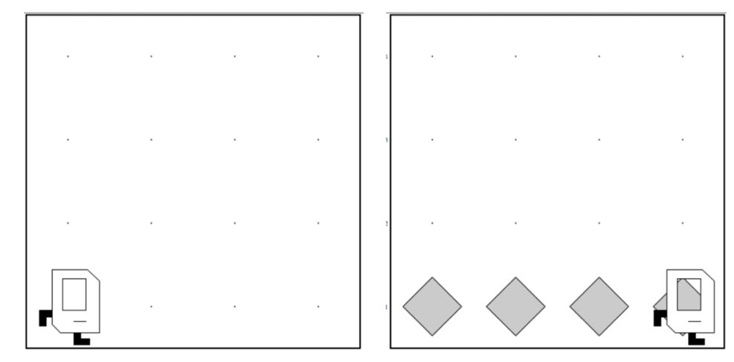
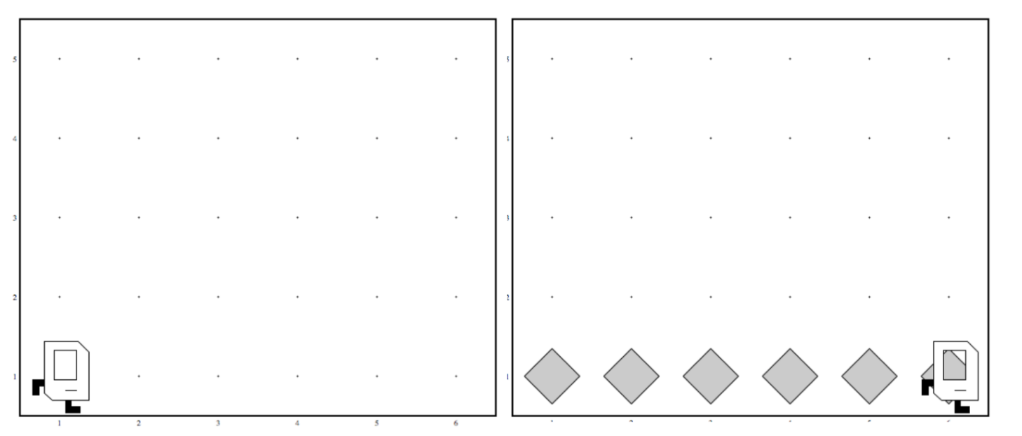
Work in Any World
Before
After
Before
After

Slide 6
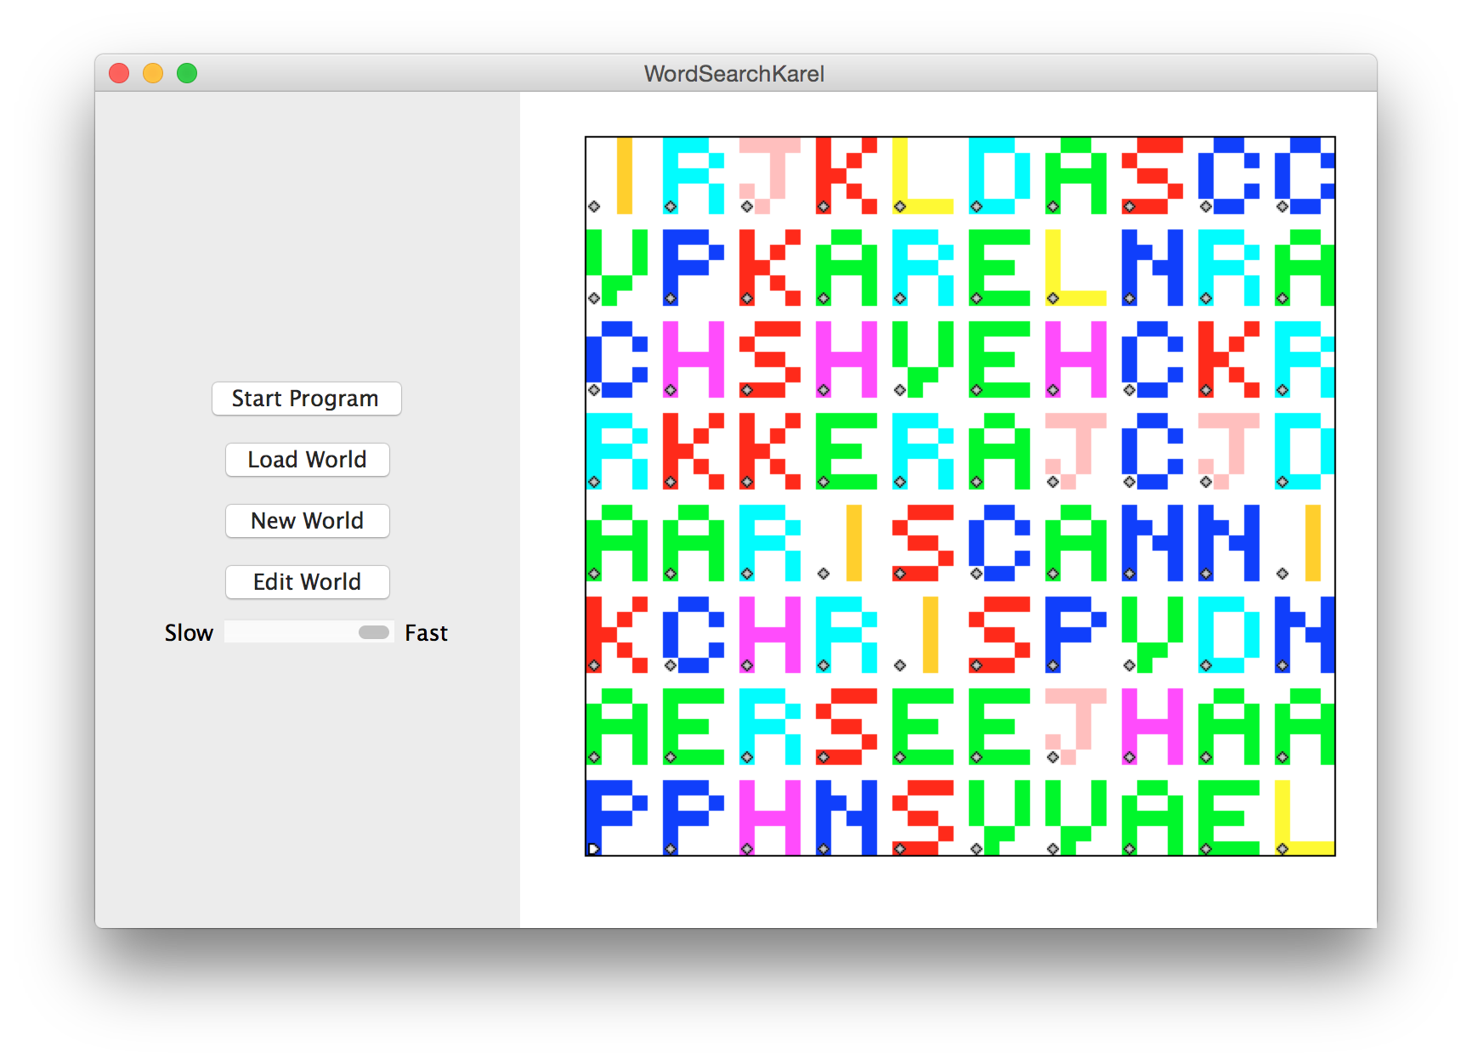

Slide 7
Midpoint Karel

Slide 8

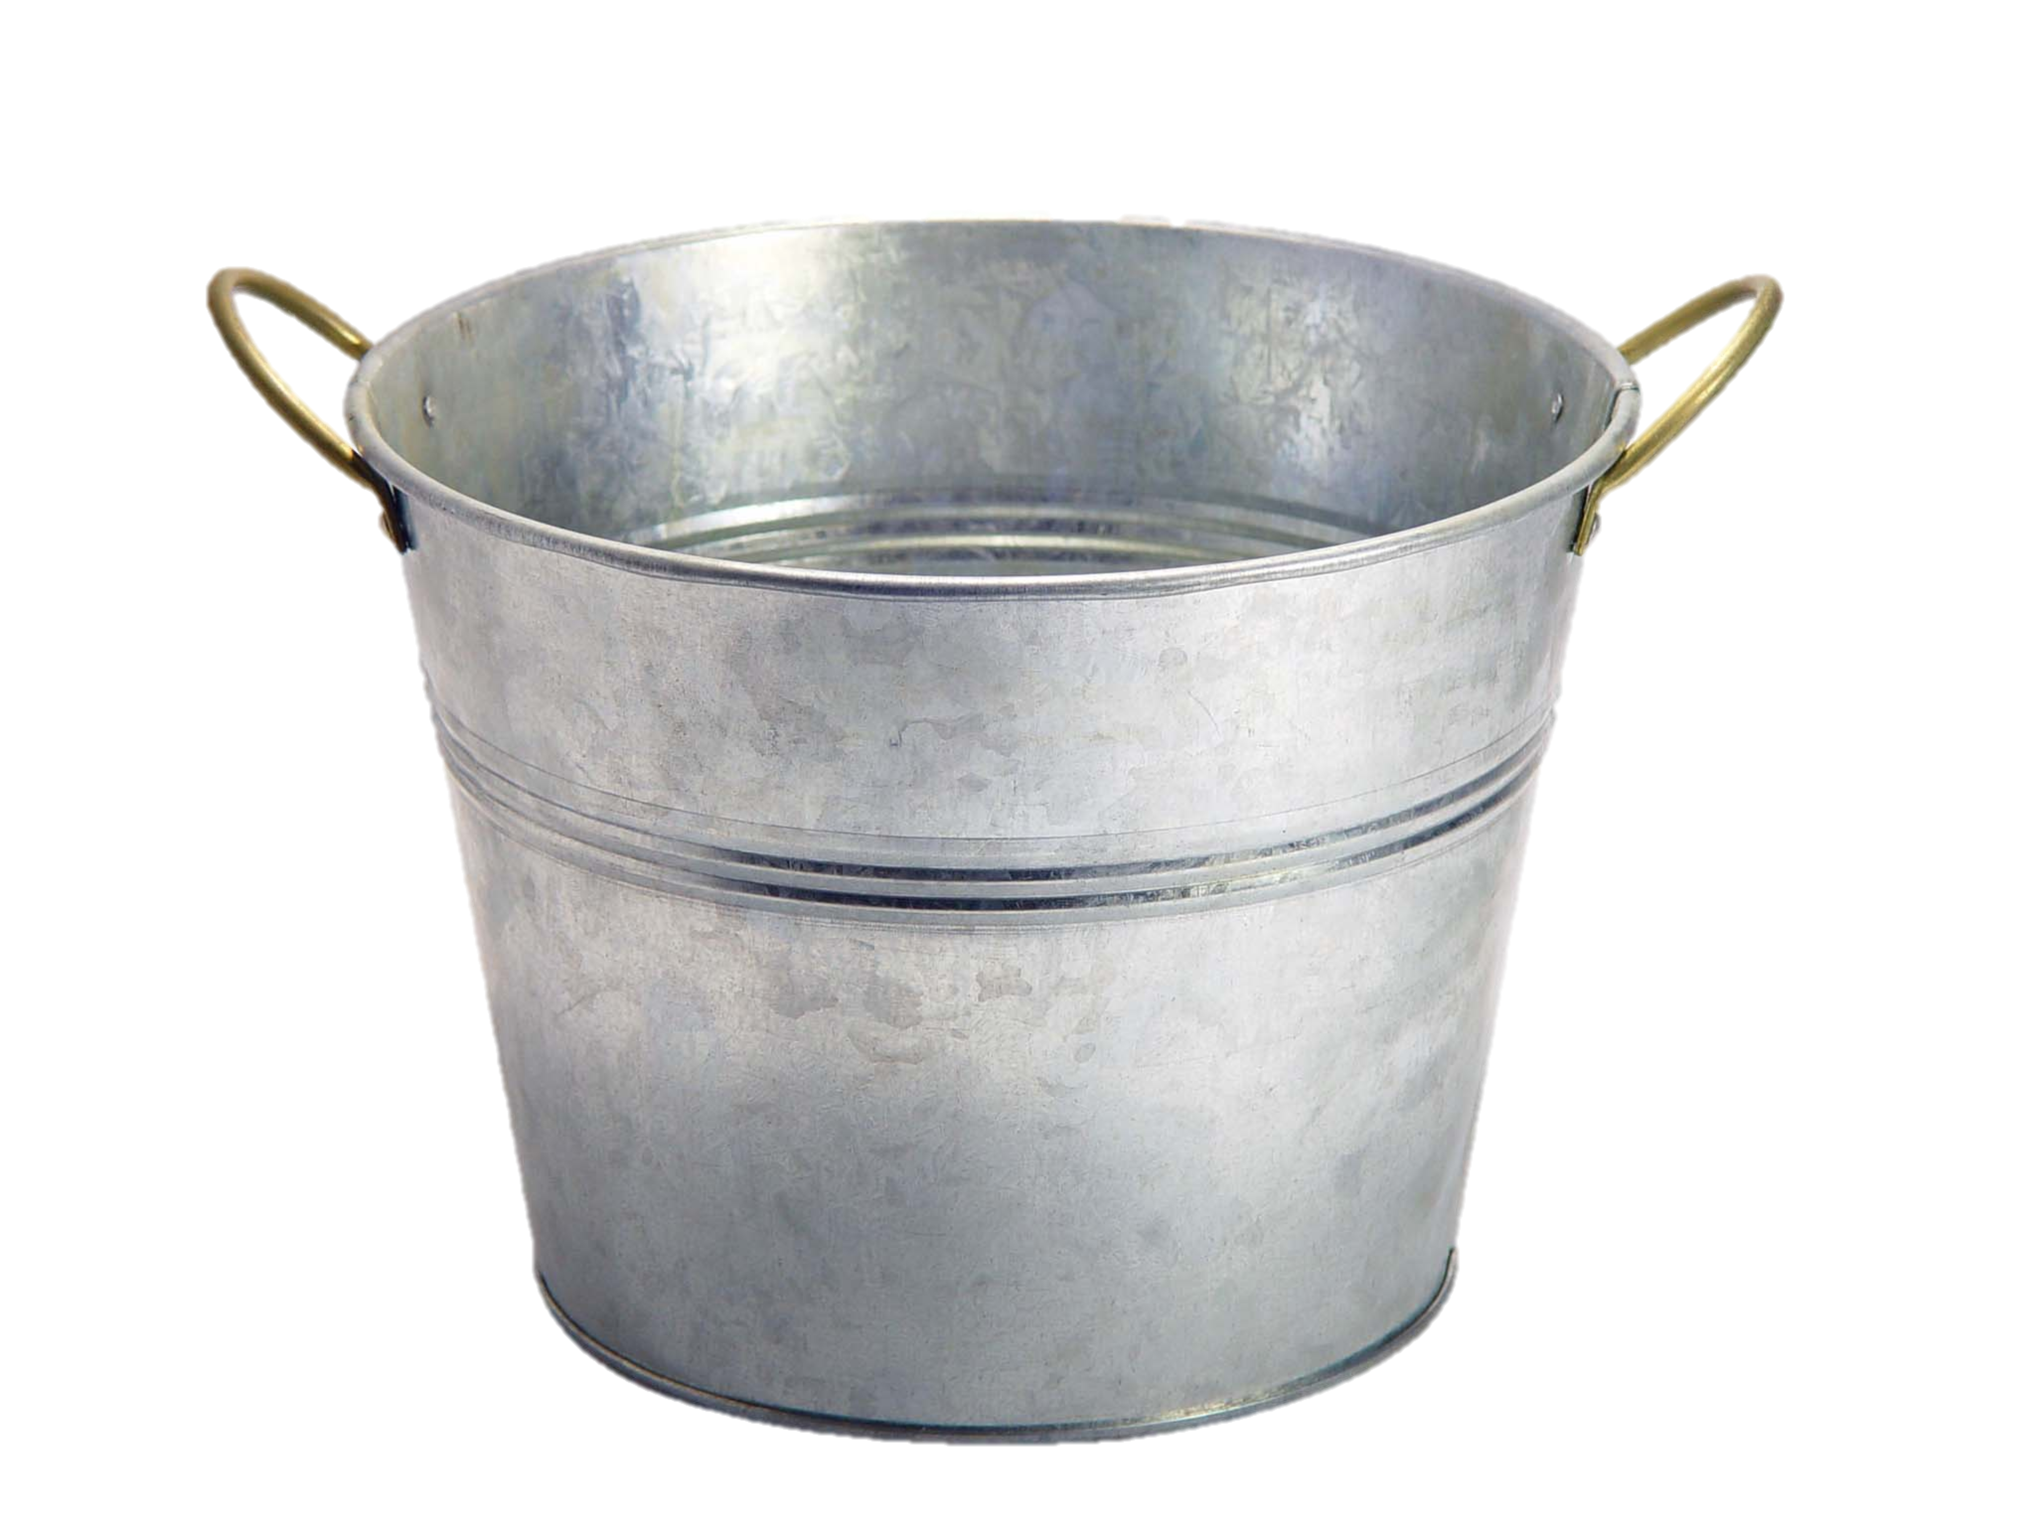
Variables are Like Boxes

Slide 9

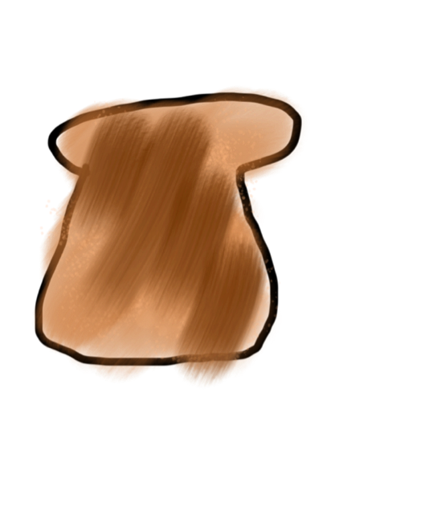

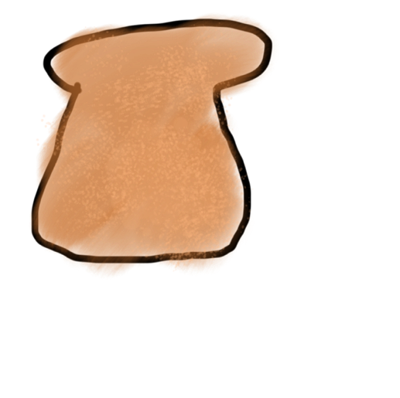
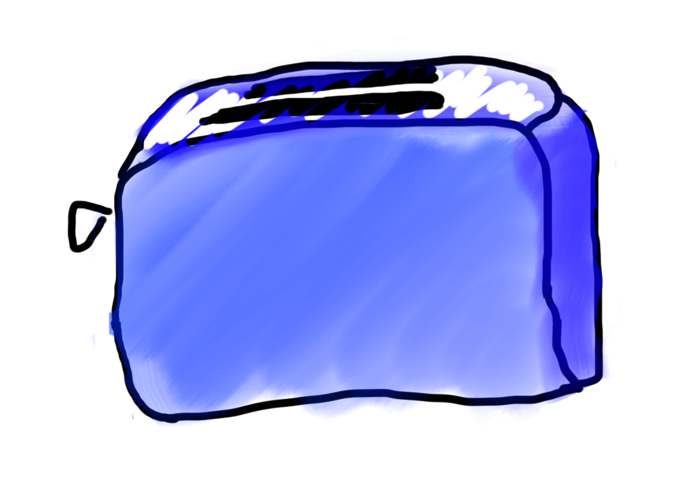
Methods are Like Toasters
parameter(s)
return

Slide 10
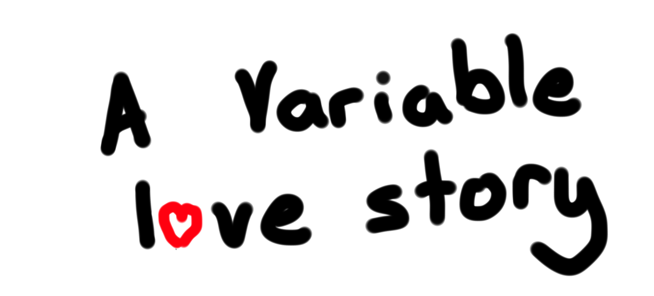
Chapter 2

Slide 11
You will be able to write Bouncing Ball

Slide 12



Add Mouse Listener
Run Method
Mouse Moved Method
Mouse Listener
addMouseListeners();

Slide 13
Objects store memory addresses
public void run() {
GRect r = new GRect(50, 50);
}
stack
heap
run
memory.com/18
r
memory.com/18

Slide 14
Breakout

Slide 15

Chris’ Favorite Program
Bright Simons

Slide 16
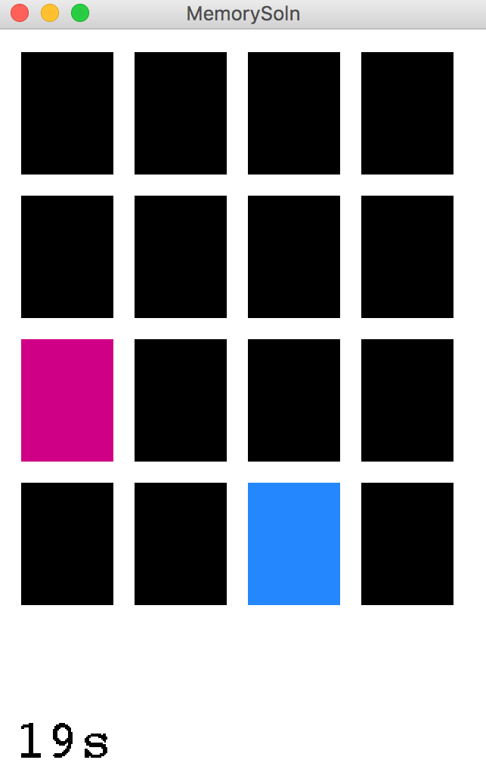
Today, we build!

Slide 17
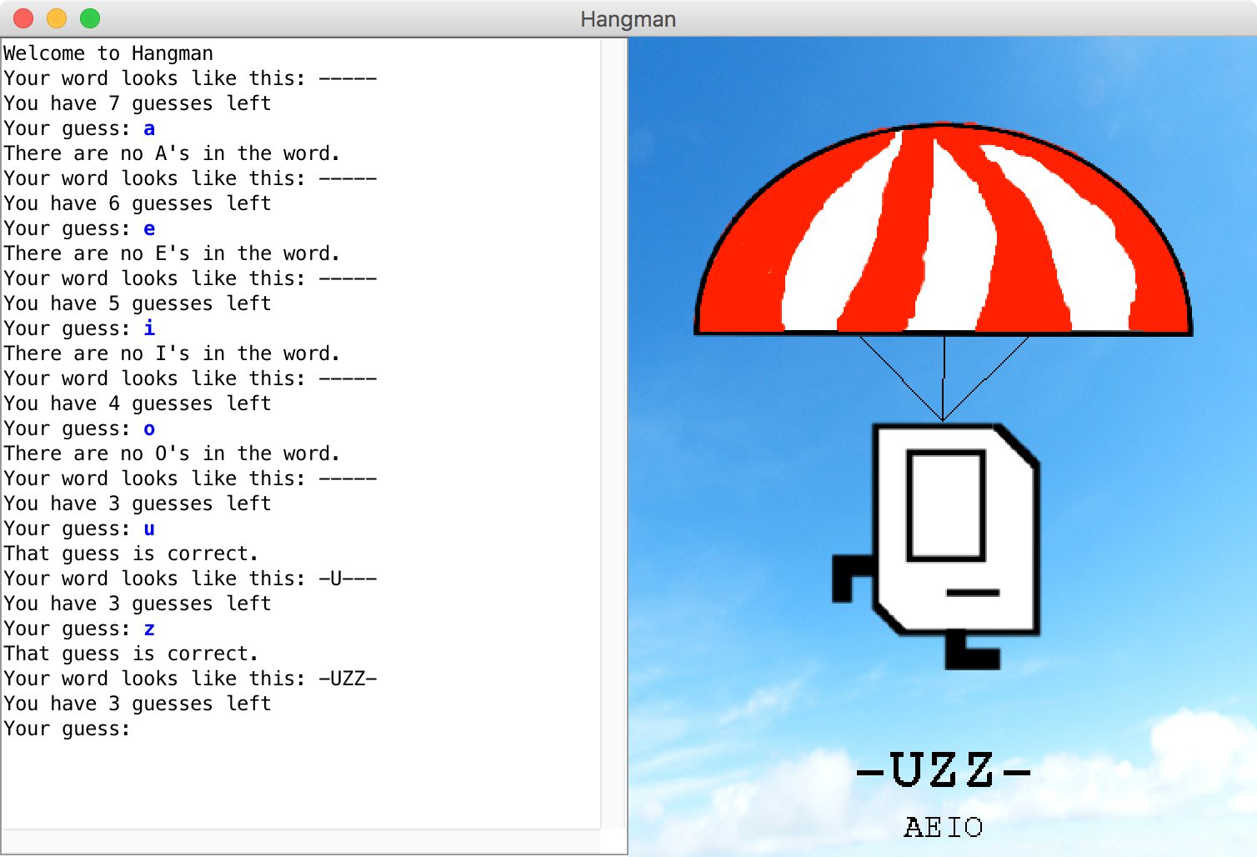
Hangman

Slide 18
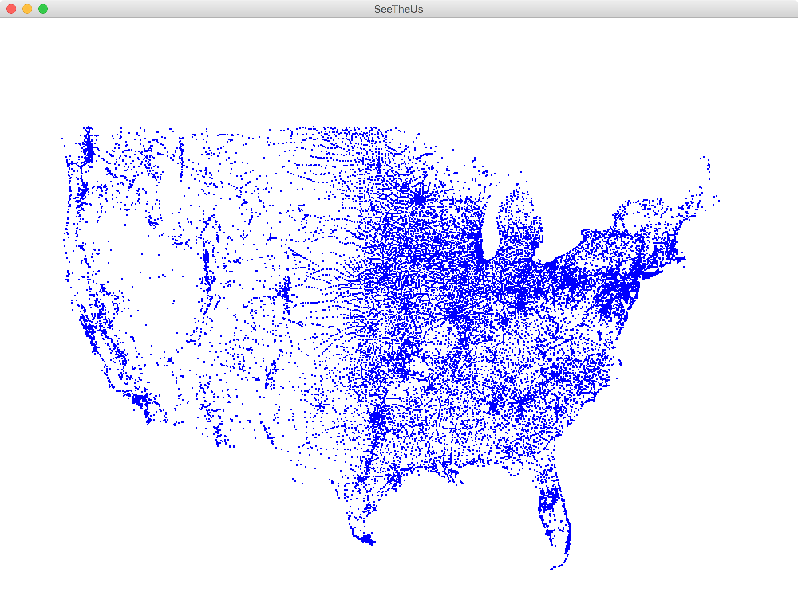
Files
Each blue dot is a tiny GRect

Slide 19
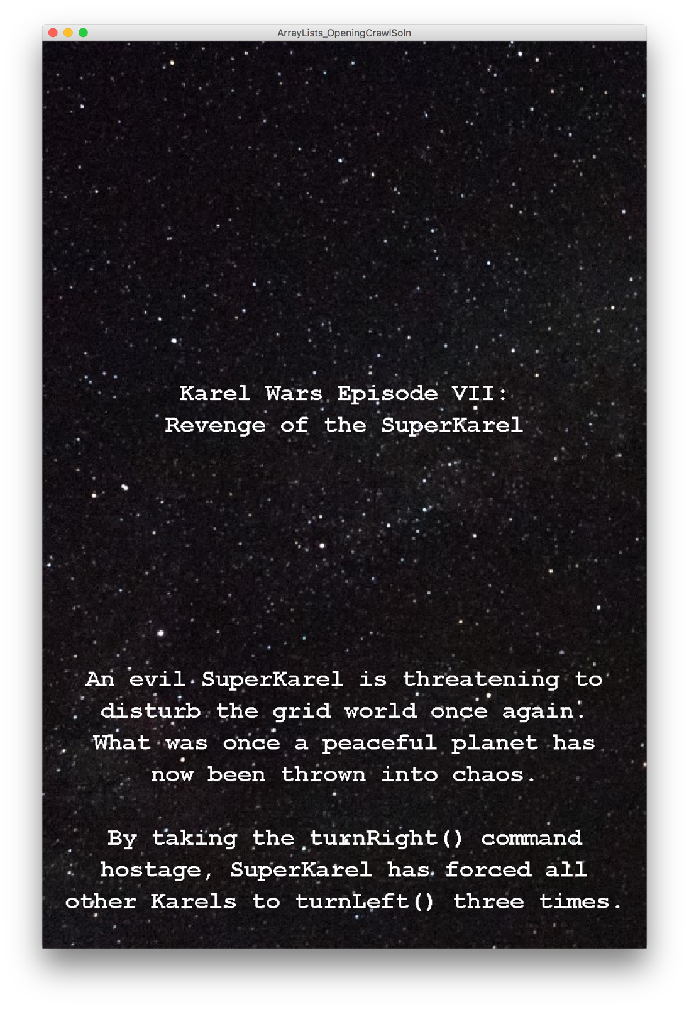
Karel Wars
Notes:
DEMO

Slide 20
Eric Roberts

Slide 21
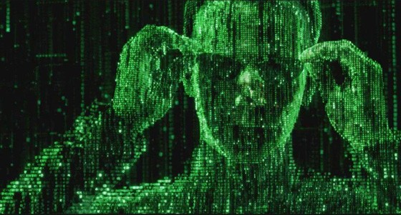
The Matrix

Slide 22
Surat

Slide 23
Yahtzee

Slide 24
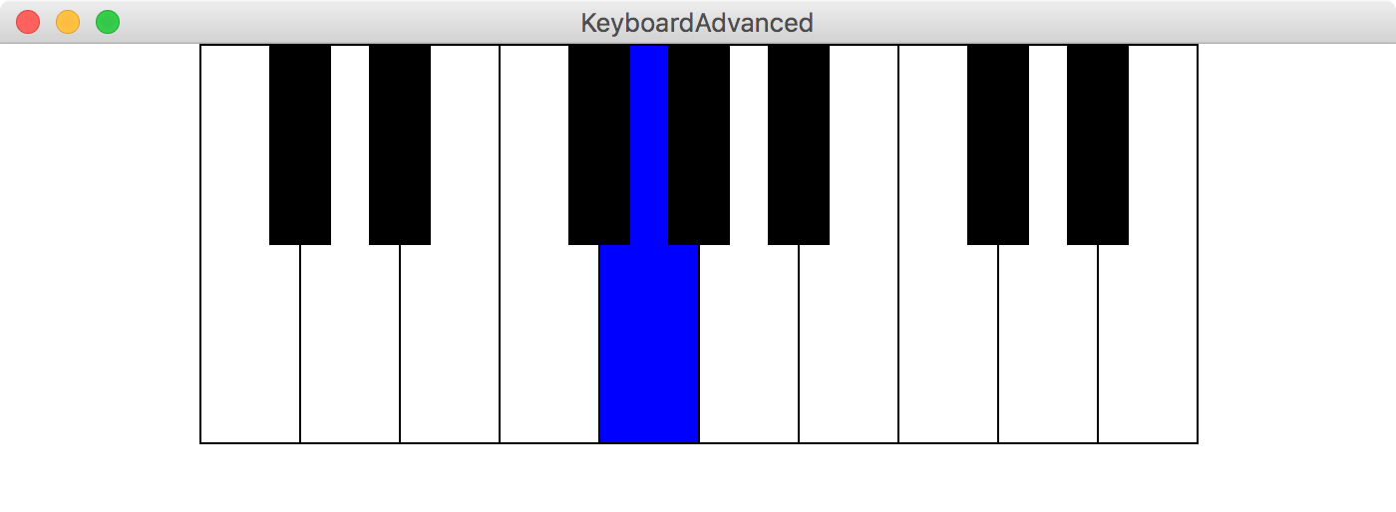
Make a keyboard

Slide 25
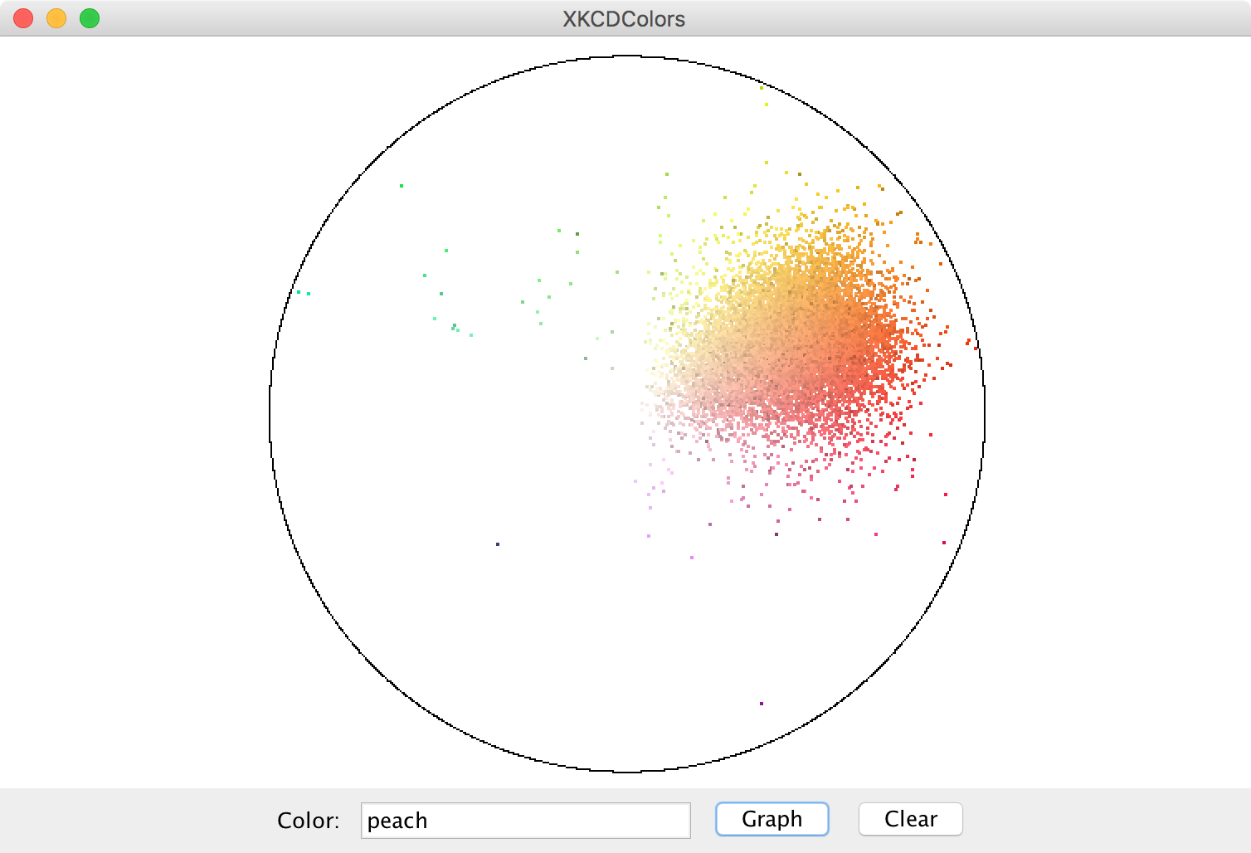
Color Map

Slide 26
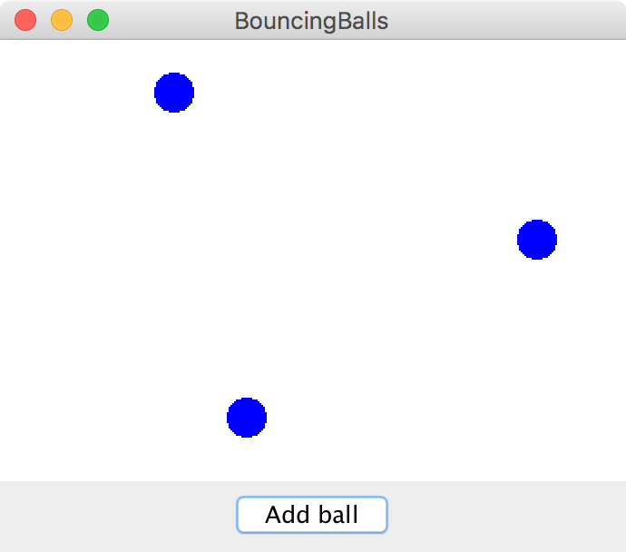
Bouncing Balls

Slide 27
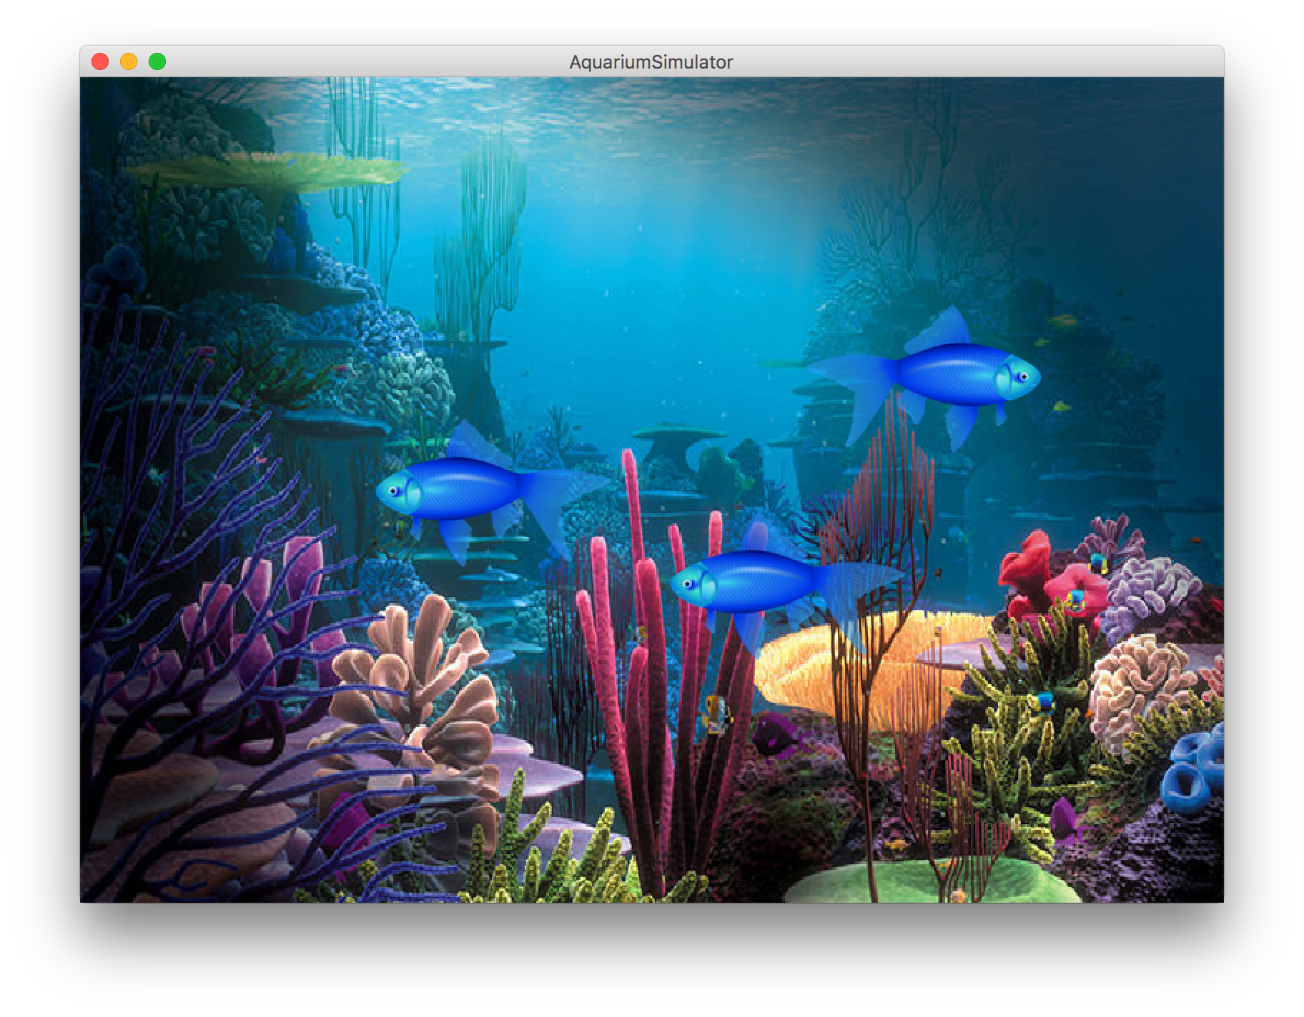
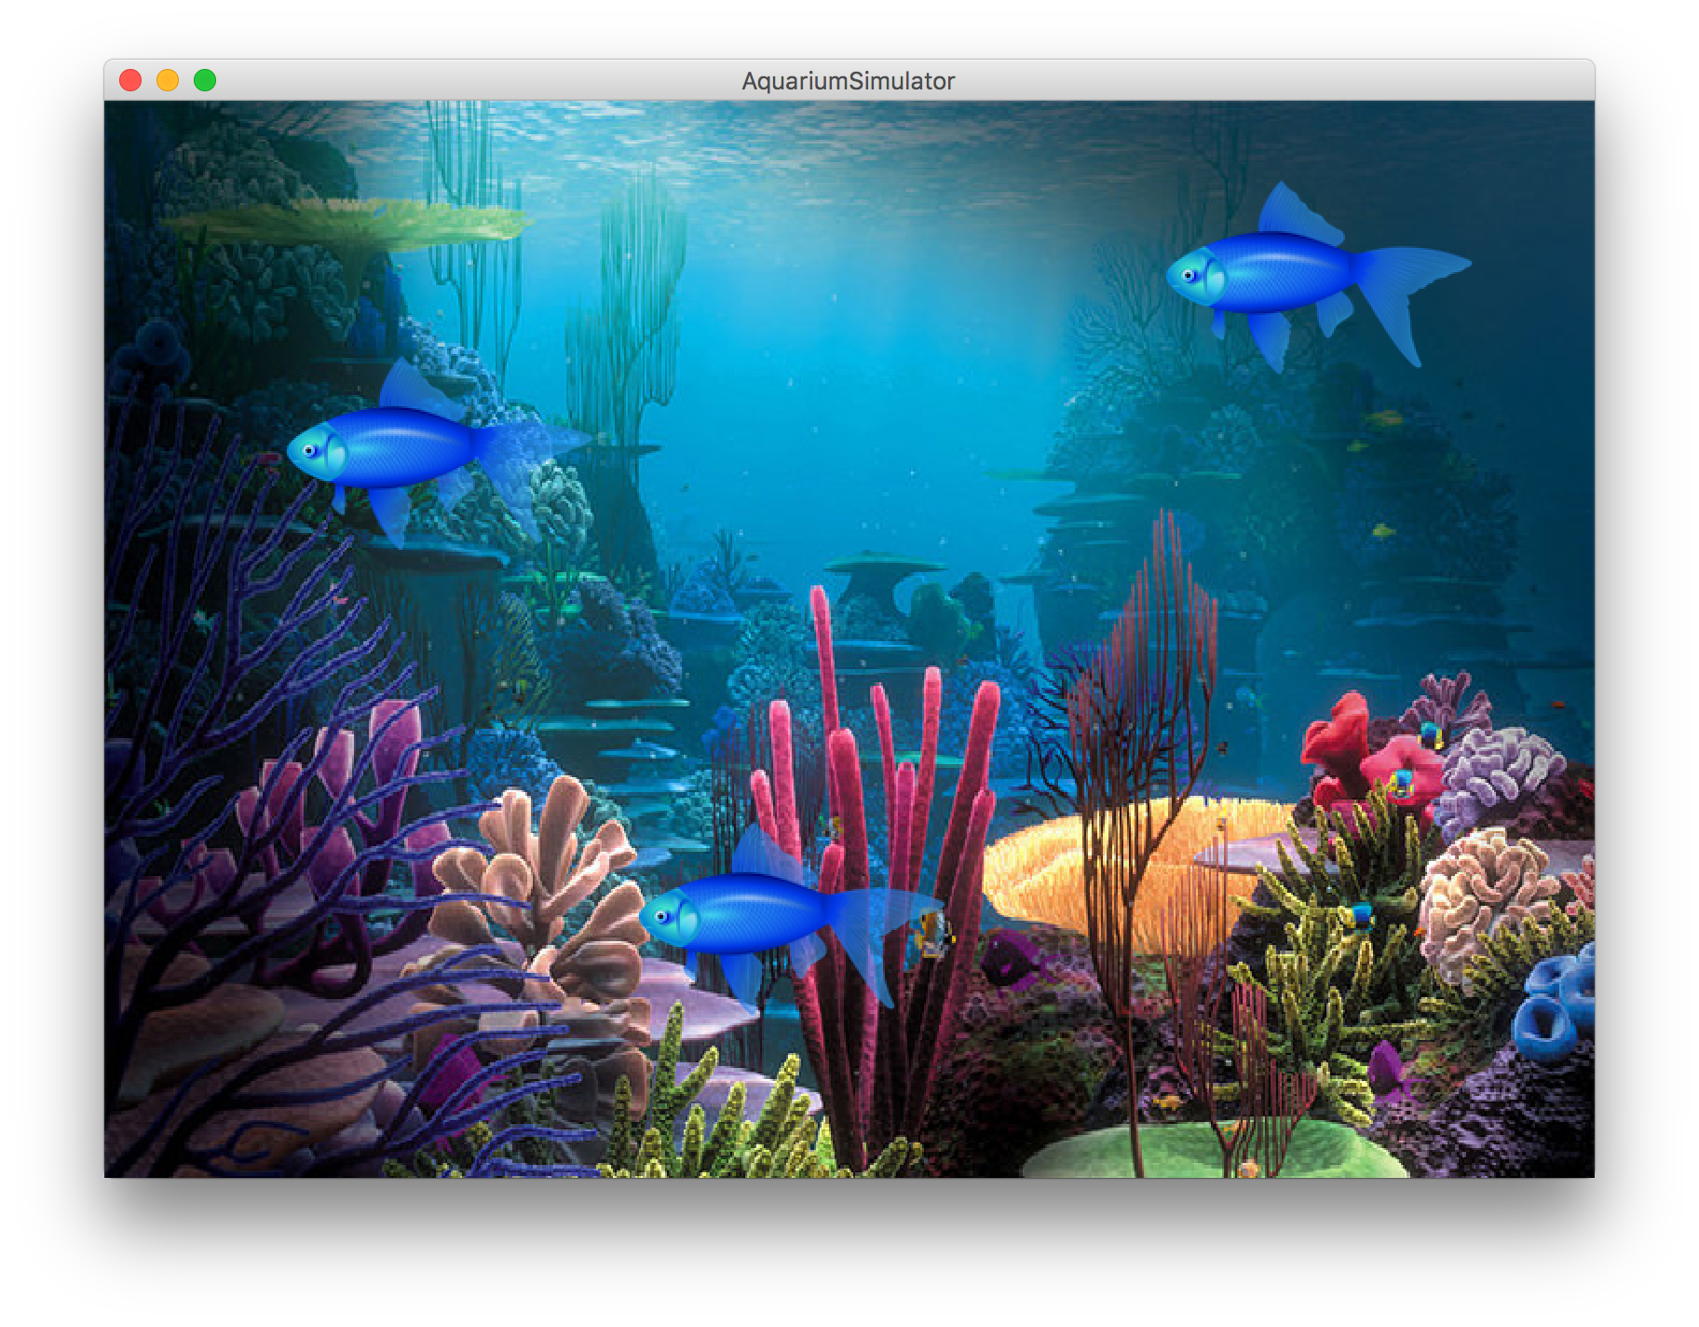

Slide 28
NameSurfer

Slide 29
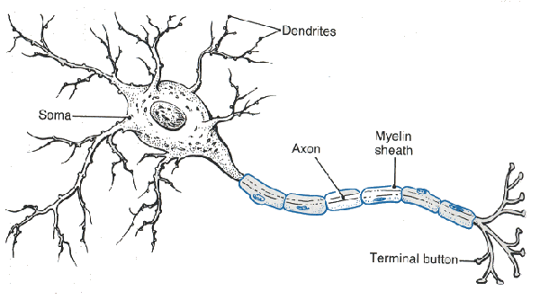
Neural Networks

Slide 30
Server / Client
Face Book Server
Send the status for
piech@cs.stanford.edu
Chris Piech
“Teaching”
Status: Chris is teaching
Set status:

Slide 31
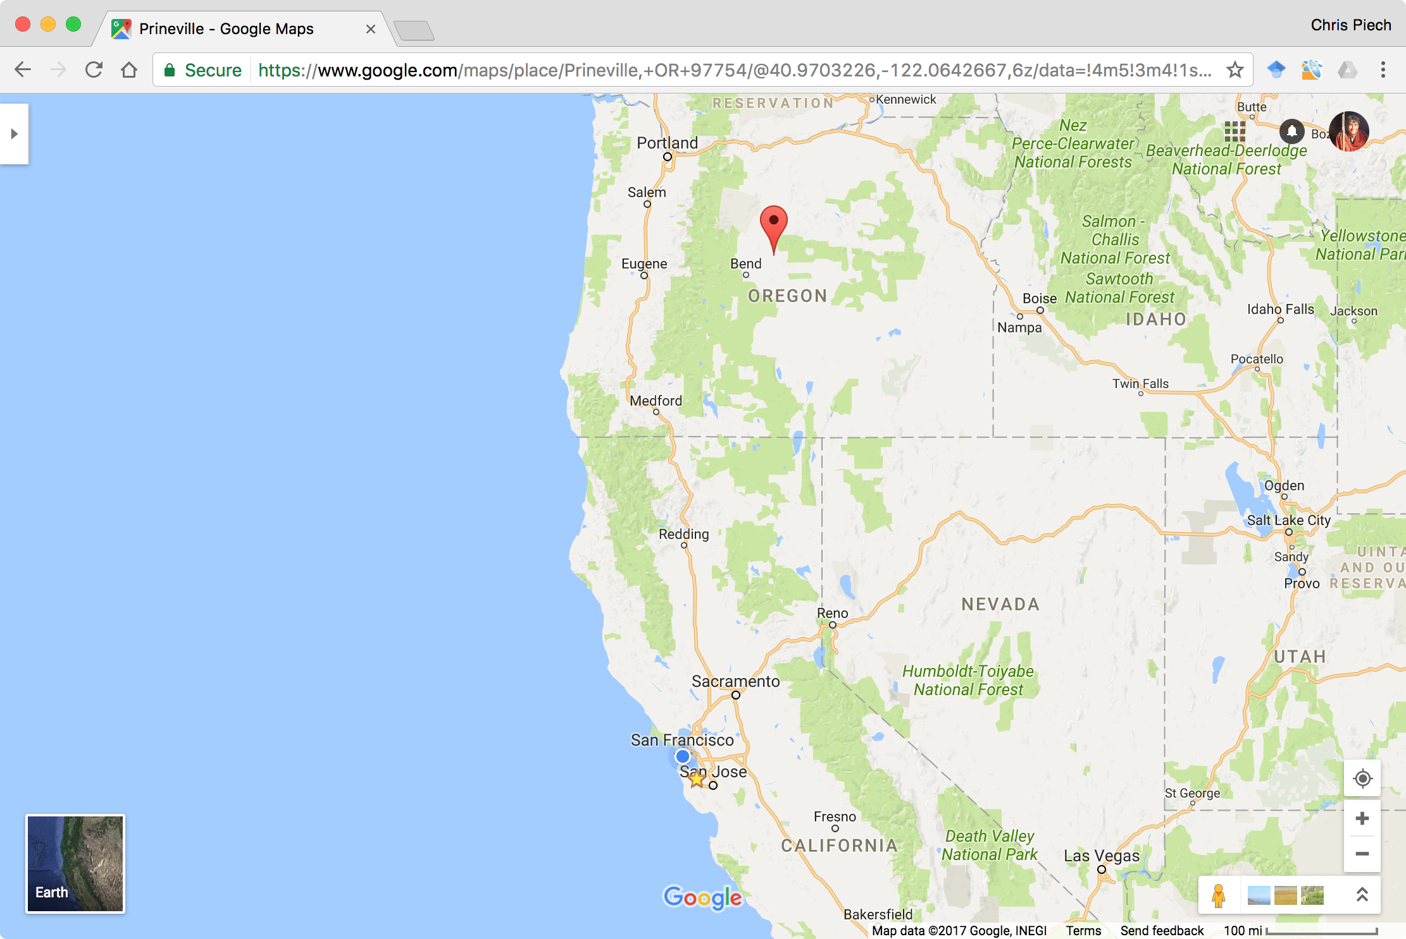
How the internet works
Face Book Server
The Internet

Slide 32
FacePamphlet

Slide 33
CS106B
Java in the Wild
Other Languages

Slide 34
CS106B
Java in the Wild
Other Languages

Slide 35
Graphics
Theory
Parallel Coding
CS106B
CS106A
Comp Bio
A.I
Applica-tions

Slide 36
CS106A: Learn the fundamental principles in how to program

Slide 37
CS106B: Learn core ideas in how to
model and solve complex problems with computers

Slide 38
Any sufficiently advanced technology is indistinguishable from magic
- Arthur Clark

Slide 39
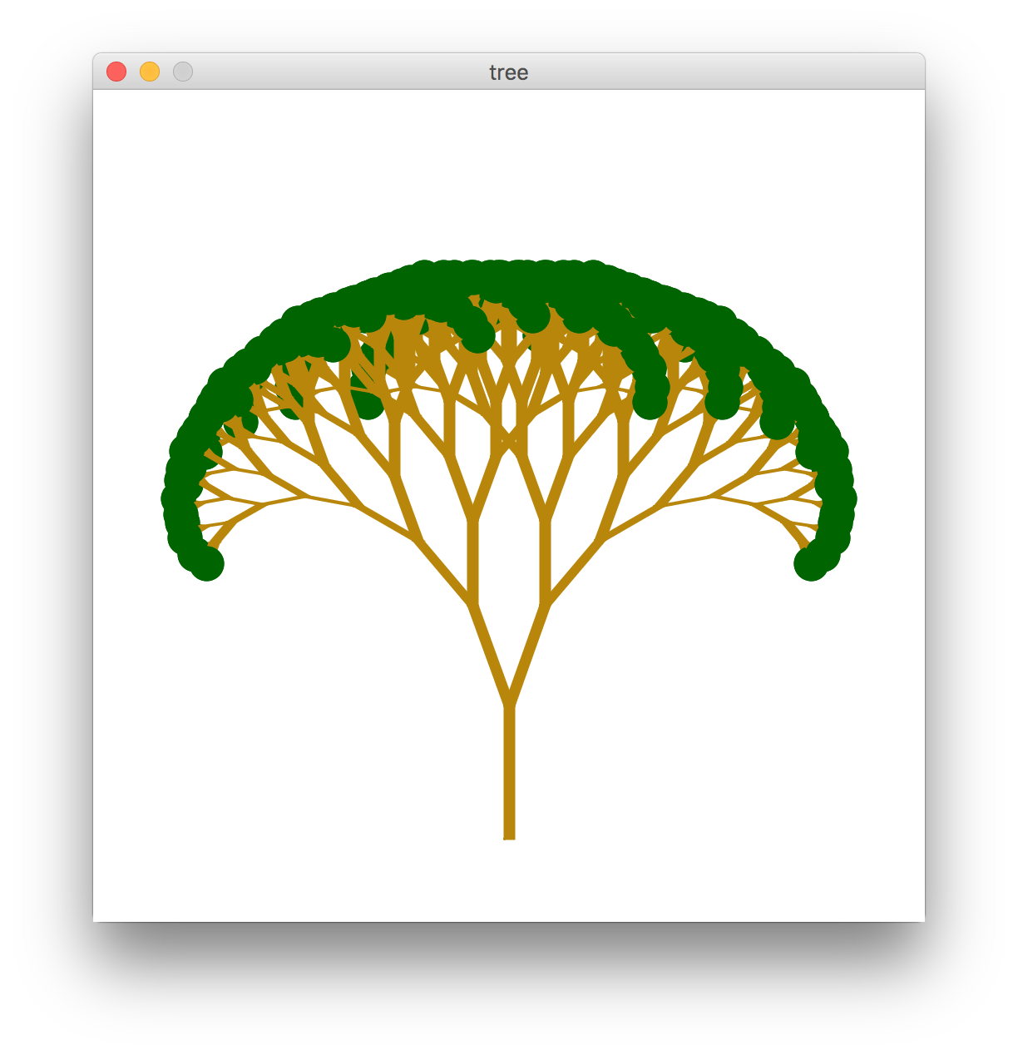
New Way of Thinking

Slide 40

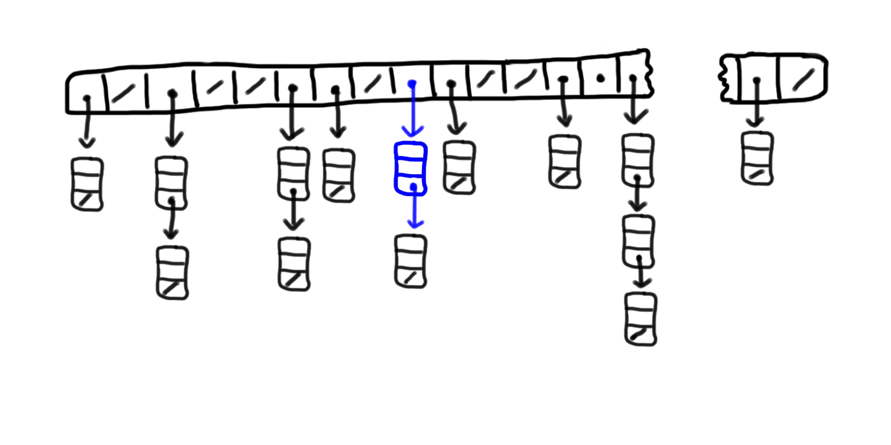
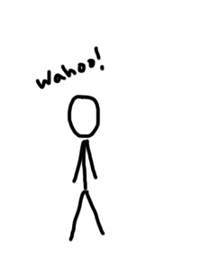
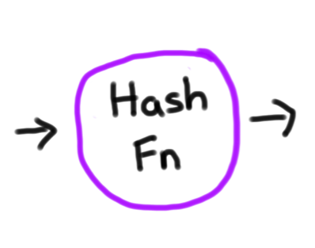

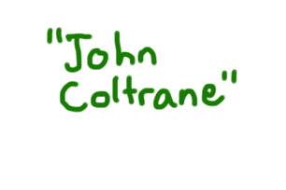
How does a Hash Map really work?
Wikipedia:
7
8
9
10
11
12
13
14
49,999
0
1
2
3
4
5
6

Slide 41
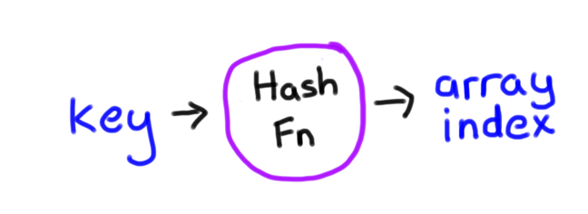

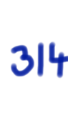
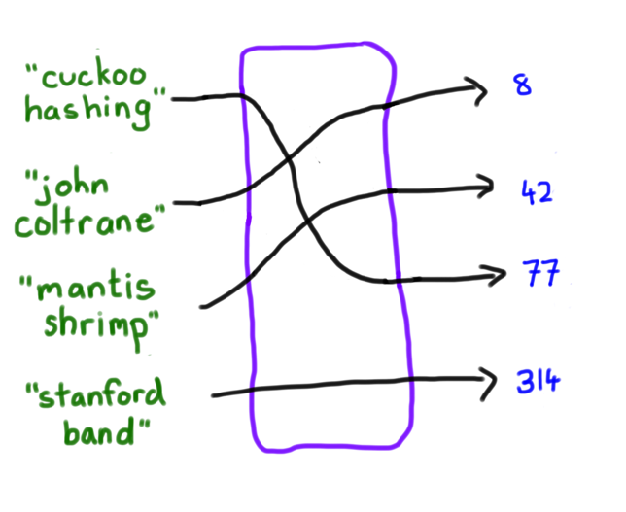
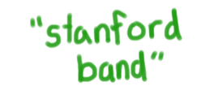
Same idea is used for internet security
int hash(string key);
1. Consistent
2. Well Distributed
Hash Fn

Slide 42
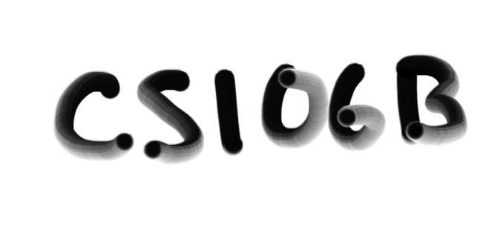


Hashzam
Source: Shazam

Slide 43
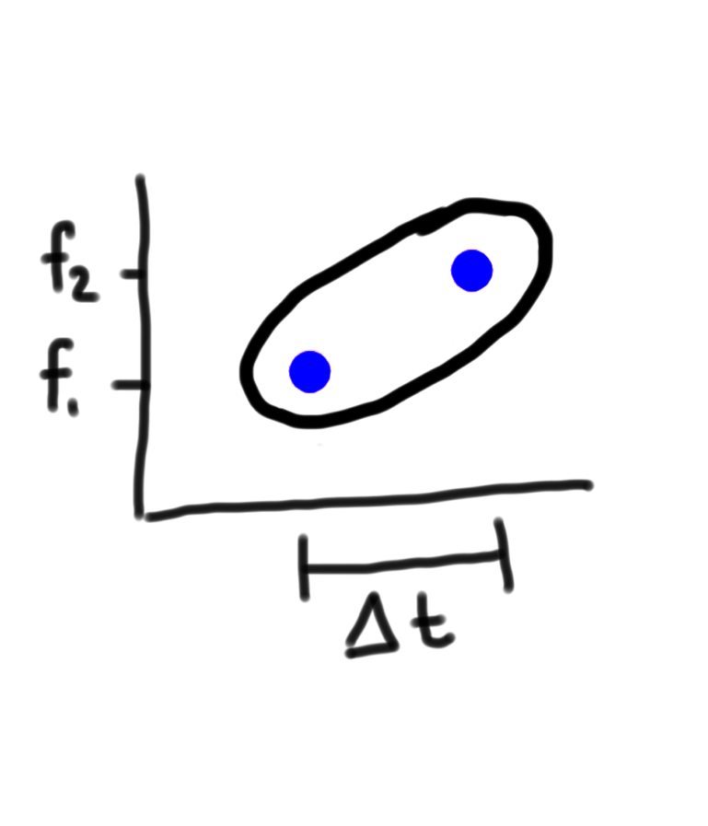
Note Pairs
Wang, A. An Industrial-Strength Audio Search Algorithm

Slide 44
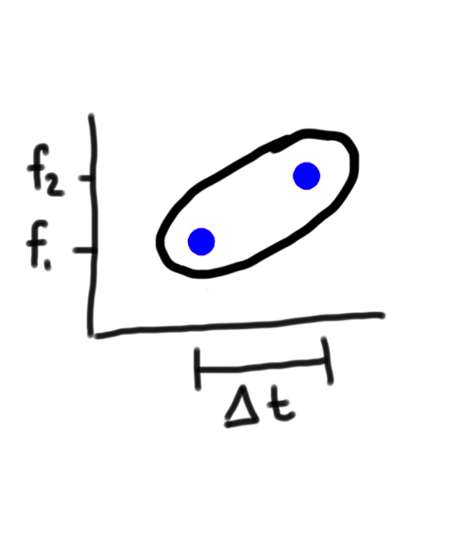
Note/Song Mapping
Shazam
PhoneBook
Key:
Key:
“Jenny”
Value:
867-5309
Value:
You Can Call Me Al – Paul Simon. 7s,
You Can Call Me Al – Paul Simon. 43s,
All Right Now – Police. 18s
Wang, A. An Industrial-Strength Audio Search Algorithm

Slide 45
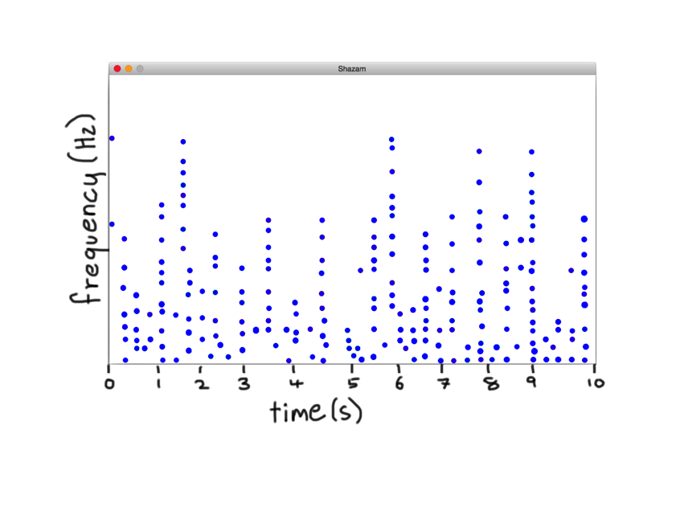
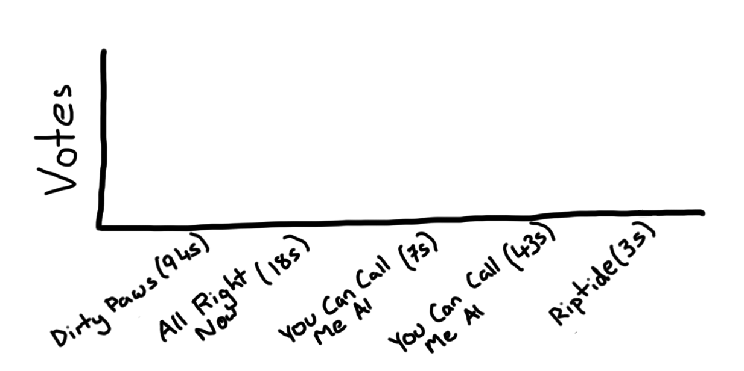
Note Pair Hashing

Slide 46


Note Pair Hashing

Slide 47

Note Pair Hashing
Window for n

Slide 48

Note Pair Hashing

Slide 49
Note Pair Hashing

Slide 50
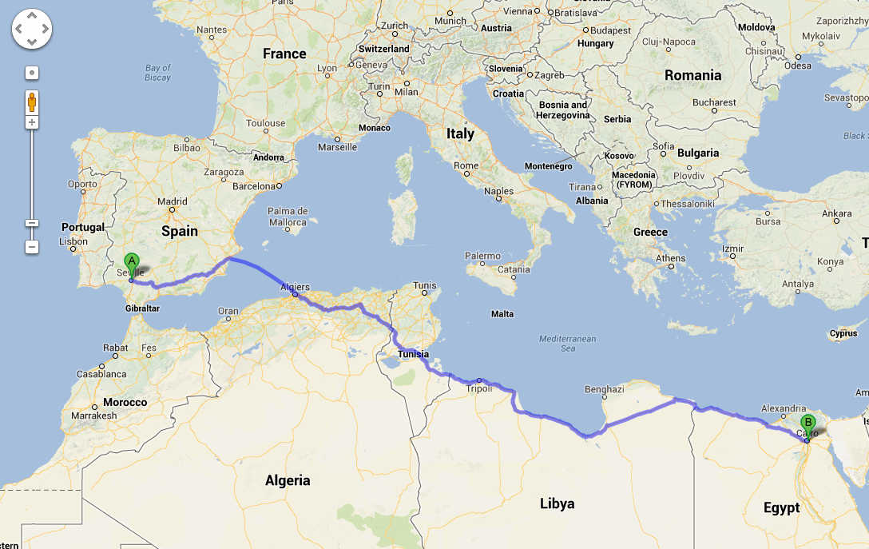
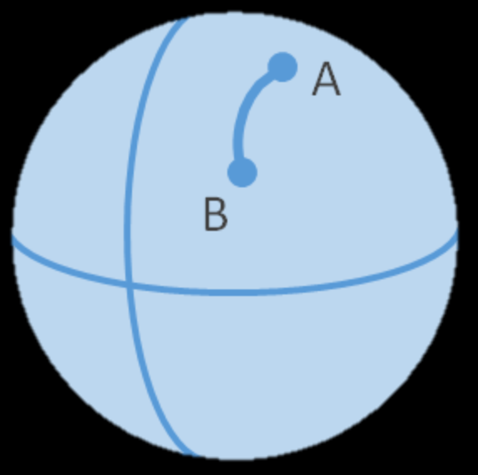
Search is Important
Google Maps

Slide 51
C++

Slide 52
Eclipse is the ide for Java
Eclipse is the ide for C++ (CS106B

Slide 53

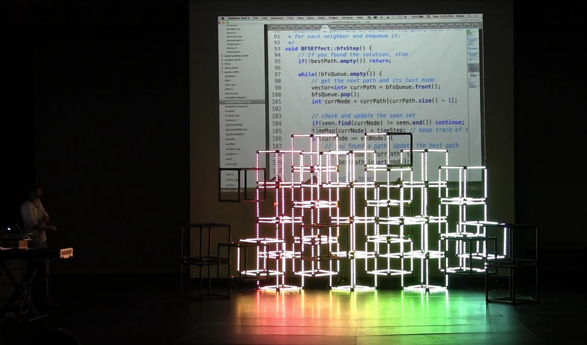
CS106B For Art
Notes:
MARKET SIZE
PURPOSE: The market for lighting in live shows is huge and growing
QUESTION: What is the market opportunity?

Slide 54
CS106B
Java in the Wild
Other Languages

Slide 55
CS106B
Java in the Wild
Other Languages

Slide 56
Java in the wild

Slide 57
There is more Java to be learned
switch
Interface
@Override
casting

Slide 58
Switch
String getMonthName(int monthNum)
8
“August”
1
“January”

Slide 59
Without Switch
String getMonthName(int monthNum) {
if(monthNum == 1) return “January”;
if(monthNum == 2) return “February”;
…
if(monthNum == 12) return “December”;
}

Slide 60
With Switch
String getMonthName(int monthNum) {
switch(monthNum) {
case 1: return “January”;
case 2: return “February”;
…
case 12: return “December”;
}
}
*Beware, switch has unexpected behavior if you have a return or end in a break statement

Slide 61
Switch, now with Strings
String requestReceived(Request request) {
switch(request.getCommand()) {
case “ping”: codeForPing break;
case “setStatus”: codeForSetStatus break;
…
}
}
*Beware, switch has unexpected behavior if you have a return or end in a break statement

Slide 62
Casting
int x = 5.8;

Slide 63
Casting
int x = (int)5.8;
* Floors the number (this results in 5)

Slide 64
Casting
Take this value
int x = (int)5.8;
And force it to conform to this type

Slide 65
Casting
double y = 5.8;
int x = (int)y;

Slide 66
Not everything can be cast
String s = (String)5.8
*

Slide 67
Not everything can be cast
double x = (double)”5.2”;
*

Slide 68
Back to our good old friend
// convert from double to string
String s = ”” + 5.2;
// convert from string to double
double x = Double.parseDouble(“5.2”);
*

Slide 69
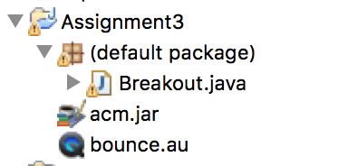
ACM and other libraries

Slide 70

How to make an “executable”
Java Archive File
Eg FacePamphletClient.jar

Slide 71
You are ready to self-learn

Slide 72
CS106B
Java in the Wild
Other Languages

Slide 73
CS106B
Java in the Wild
Other Languages

Slide 74
Other Languages

Slide 76
More like dialects
C++
Java
Python
JavaScript

Slide 77
C++
// Java
ArrayList<Double> evens = new ArrayList<Double>();
for(int i = 0; i < 100; i++) {
if(i % 2 == 0) {
evens.add(i);
}
}
println(evens);
// C++
Vector<double> evens;
for(int i = 0; i < 100; i++) {
if(i % 2 == 0) {
evens.add(i);
}
}
cout << evens << endl;

Slide 78
Python
// Java
ArrayList<Double> evens = new ArrayList<Double>();
for(int i = 0; i < 100; i++) {
if(i % 2 == 0) {
evens.add(i);
}
}
println(evens);
# Python
evens = []
for i in range(100):
if i % 2 == 0:
evens.append(i)
print list

Slide 79
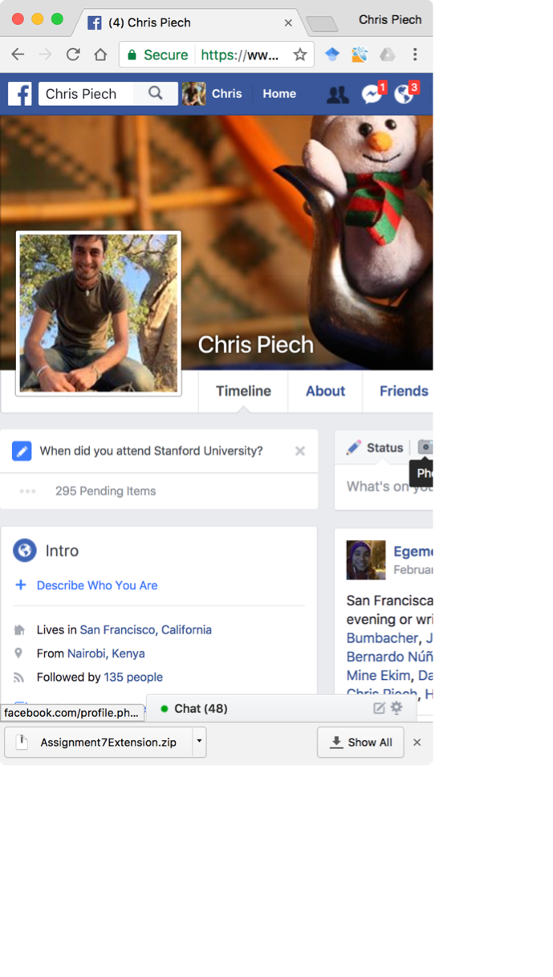
JavaScript
// Java
ArrayList<Double> evens = new ArrayList<Double>();
for(int i = 0; i < 100; i++) {
if(i % 2 == 0) {
evens.add(i);
}
}
println(evens);
// JavaScript
var evens = []
for(var i = 0; i < 100; i++) {
if(i % 2 == 0) {
evens.push(i)
}
}
console.log(list)

Slide 80
Some may think:
Computer science is vocational
Notes:
The right way to think about computer science in our education system is that it is foundational

Slide 81
Some may think:
Computer science is vocational
Computer science is foundational
Notes:
The right way to think about computer science in our education system is that it is foundational

Slide 82
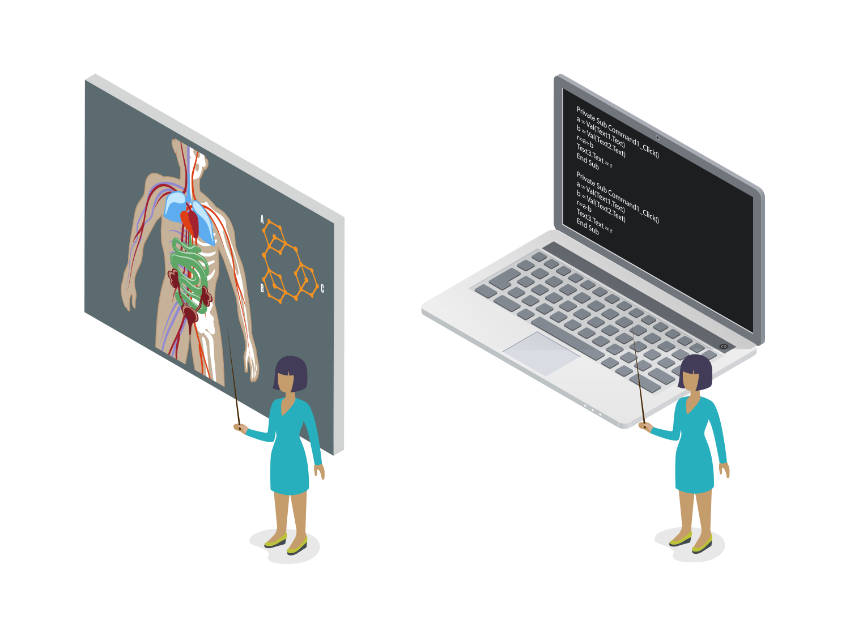
Computational thinking is foundational
Just like you learn about the digestive system, photosynthesis, or electricity.
Notes:
So let’s take a little audience pop-quiz
How many of you can answer these questions?
What is photosynthesis?
Or what is H2O?
These are all things that we expect kids to graduate high school knowing
Every 21st century student should also have a chance to learn about algorithms, how to make an app, or how the internet works.
Right now there’s no expectation in our schools that students will even have a basic understanding of these concepts, even though they are driving a large part of our society.
It is equally important that students understand what a “for loop” is and how it is used and how to design algorithms is as it is that they understand how to solve an equation or how plants live
The main reason that computer science is now foundational knowledge necessary in every school is because it will allow students to think about problems differently
Students will gain computational thinking skills, which embody a more robust way to think about problems
And the problem solving process can be applied to any field of study and to any problem
If you are facing a big, ambiguous project at home or at work, computational thinking and problem solving processes can help you break this problem into smaller chunks. Recognizing what’s important and what needs to be solved first are critical thinking skills that are valuable in ANY context

Slide 83
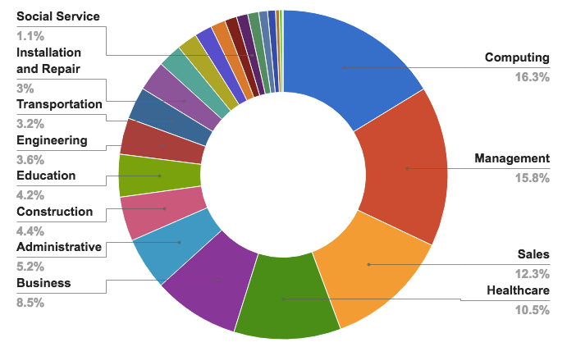
But there are vocations involved ☺
500,000 current openings: These jobs are in every industry and every state, and they’re projected to grow at twice the rate of all other jobs.
Source: Brookings Institute via Code.org

Slide 84
Acknowledge our practice

